Slide 1
SPAM
By Comsa Filip - 932/1

Slide 2
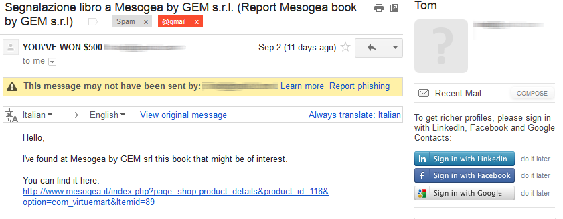
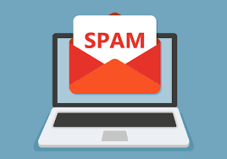
What is Spam?
When we hear the word spam, your immediate thoughts go to the well- known form of spam: email spam.
However there are other types of spam in the internet communication mediums
Notes:
We all got in our emails an email that looks like the one in the first pic. Well guess what that is spam !
such as : instant messaging, discussion boards, mobile phones with text messaging, blogs, so basically every device or client that provides a means for communications!

Slide 3
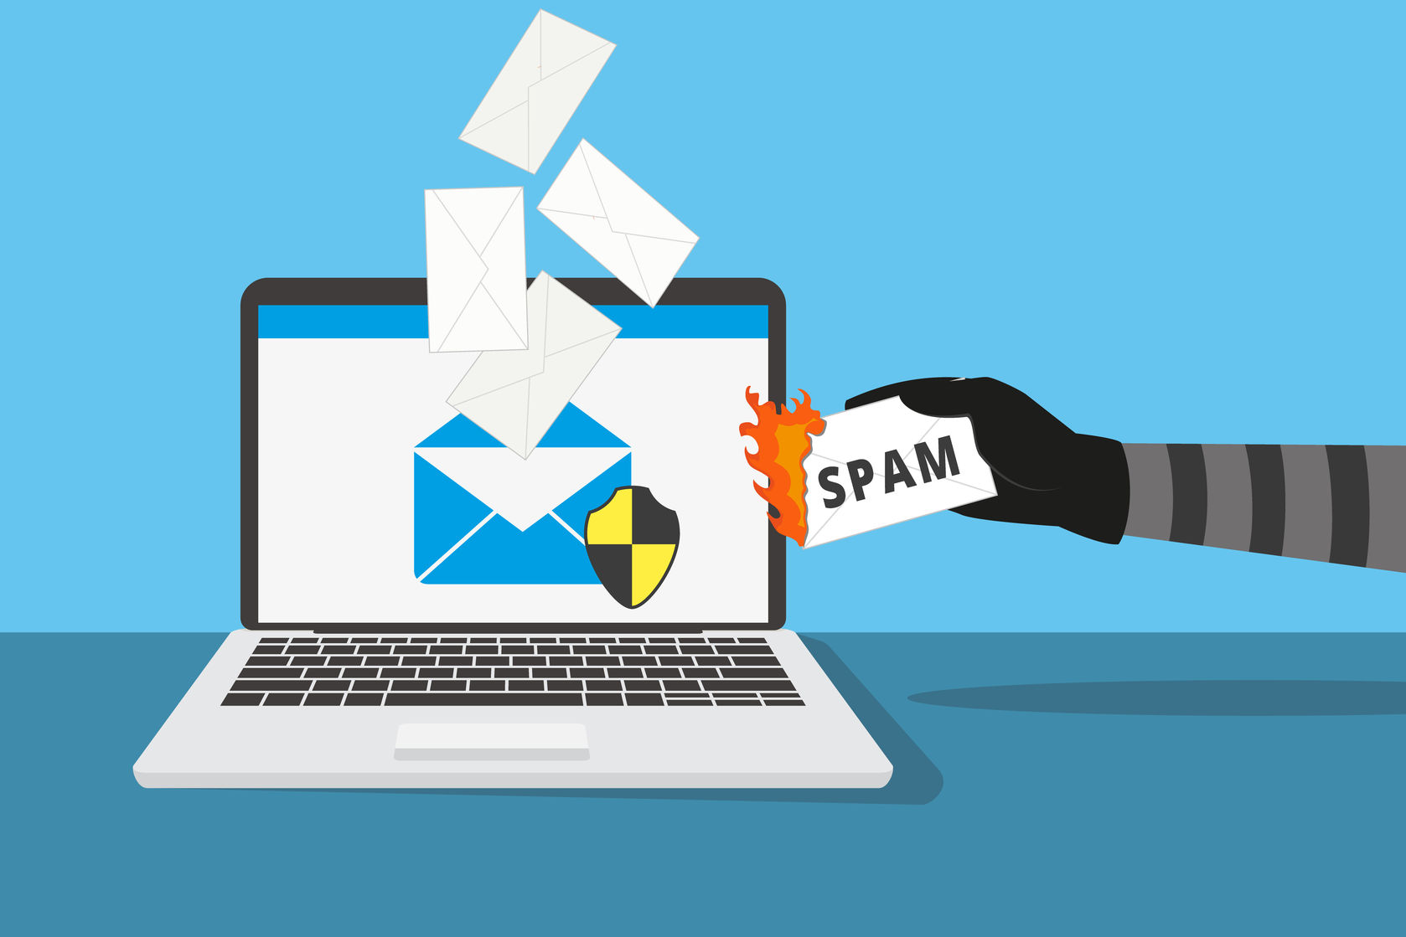
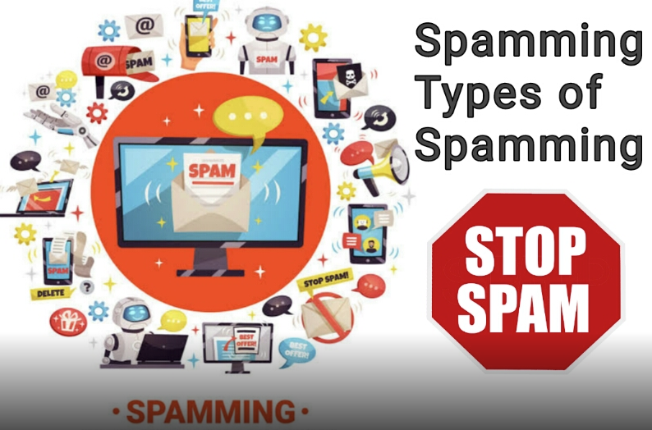
Types of spam
Notes:
As we can se in the second picture there are many types in which someone can spam someone else for example: advarising, chat bots, emais, cupons from supermarkets, private messages and so on.

Slide 4
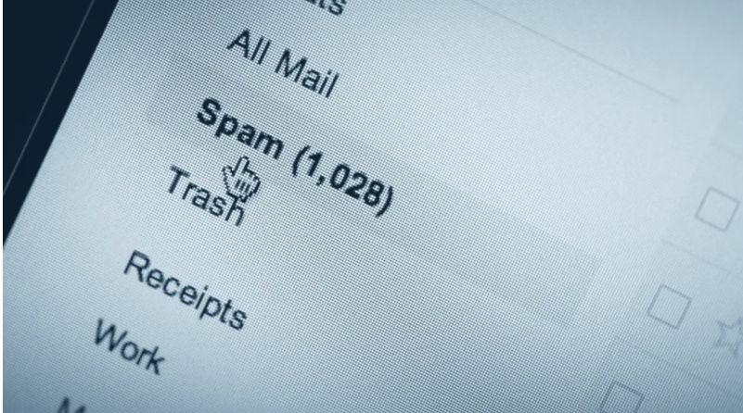
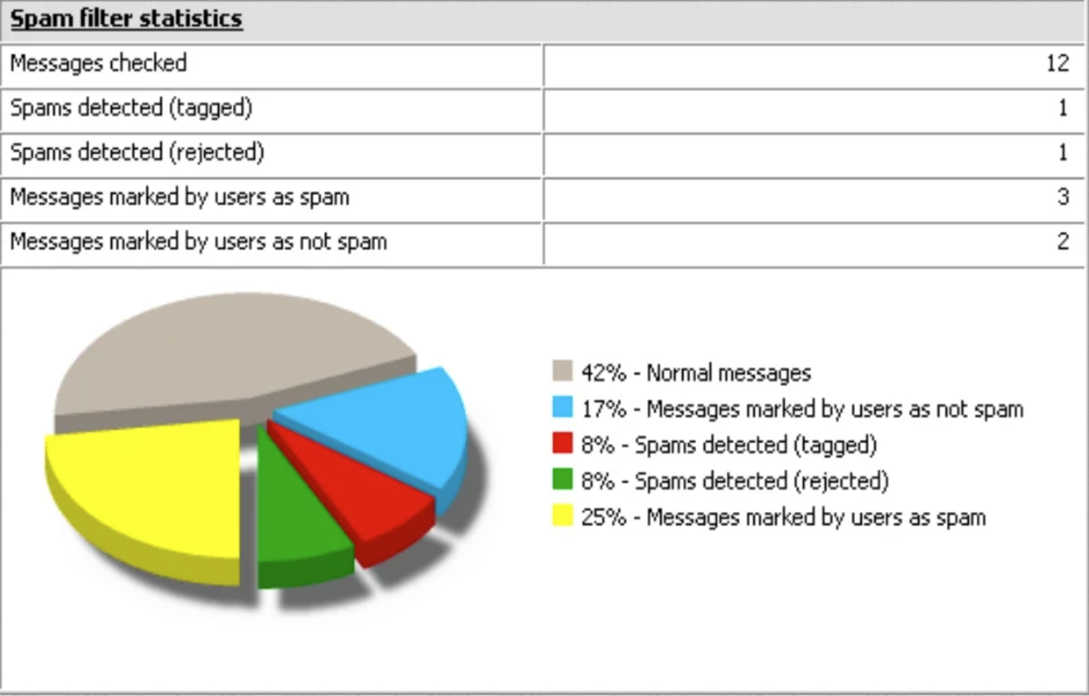
Statistics
Notes:
According to Statistics, spam messages account for 48.16 percent of email traffic worldwide. The most common types of spam email analyzed in 2017 were healthcare and dating spam.
The European Union’s Internal market Commission estimated in 2001 that junk e-mail cost Internet users 10 Billion Euro per year worldwide.
The California legislature found that spam cost United States organizations alone more than 13 billion $ in 2007

Slide 5
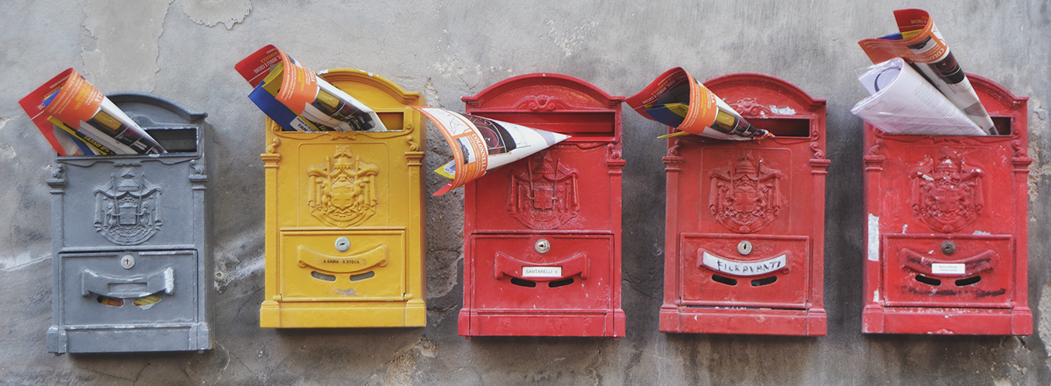
How spam used to look like for our parents?

Slide 6
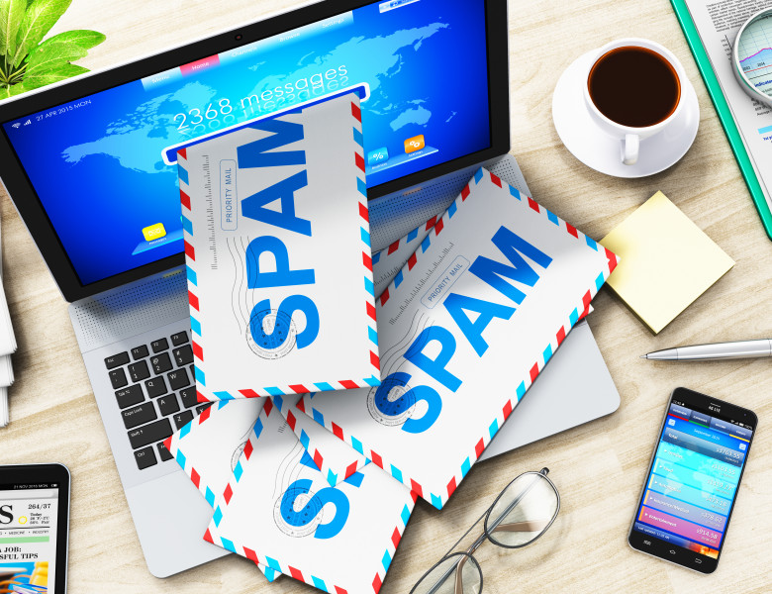
Problems associated with email Spam
Increase causes bad storage capacity, overload of email systems bandwidth
The sheer volumes of spam slows down the email traffic and eventually causing DDoS
You may forget about the emails that actually interest you.
Worst case it may access your data or insert viruses.
Notes:
DDoS stands for Distributed Denial of Service. A DDoS attack is designed to disrupt a website or network by bombarding it with traffic. Hackers and others use these attacks for a variety of reasons including spam
If the sent spam is “bounced” or sent back to the sender by various programs that eliminate spam, or if the recipient clicks on a unsubscribe link, that can cause that email address to be marked as “valid” which is interpreted by the spammer as “send me more”

Slide 7
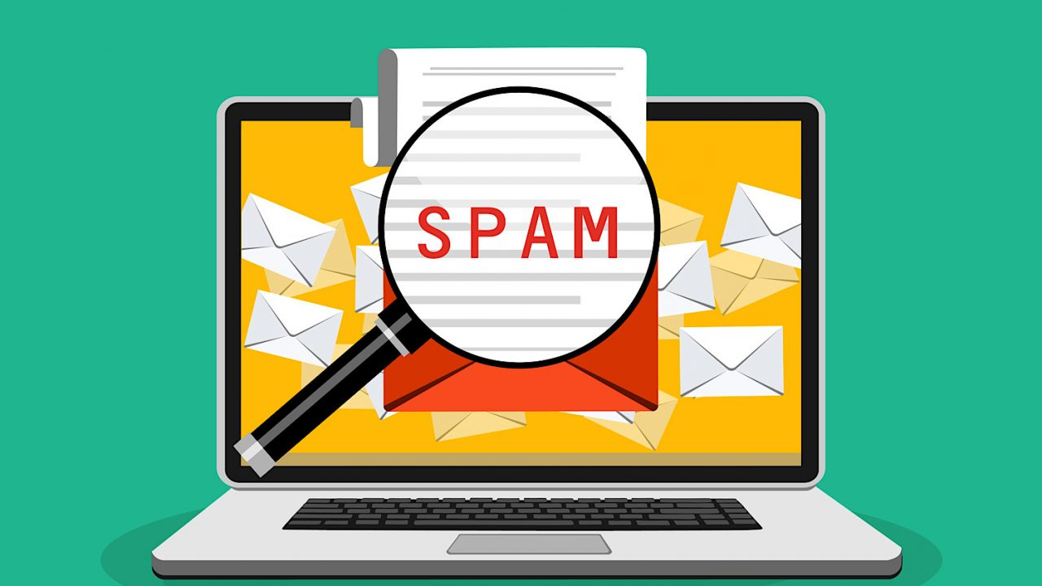
Why some people do such things ?
Email spam number have increased because e-mail spam is a cheap way to garner a few sales
Other consequence of spamming is that search engine indexes are inundated with useless pages, increasing the cost of each processed query.
Notes:
For the solicitor, the costs associated with spamming are minimal. All they need is time and enough money for an Internet connection and lists of e-mail addresses.
Spammers frequently use false name, addresses, phone numbers and other contact information to set up “disposable” accounts at various Internet service providers.
Some spammers argue that most of these costs could potentially be alleviated by having spammers reimburse ISPs and individuals for their material.

Slide 8
How to combat Spam ?
Try not to display your email address in public
Keep updating your anti-spam tech software’s up to date.
Report it to the Federal Trade Commission (FTC). Copy of unwanted or deceptive messages to spam@uce.gov.
Don’t click links in spam emails
Choose more complex email address

Slide 9
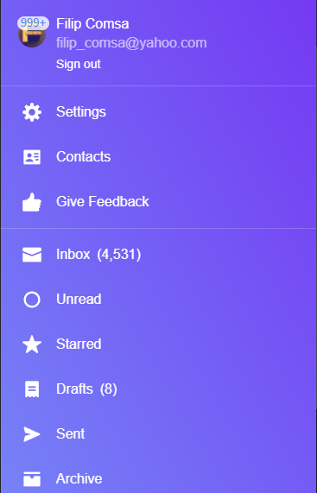
Let’s be honest
We all have that one email address that we use for sketchy websites and newsletters. So let’s all be more careful on what we click and what we access.

Slide 10
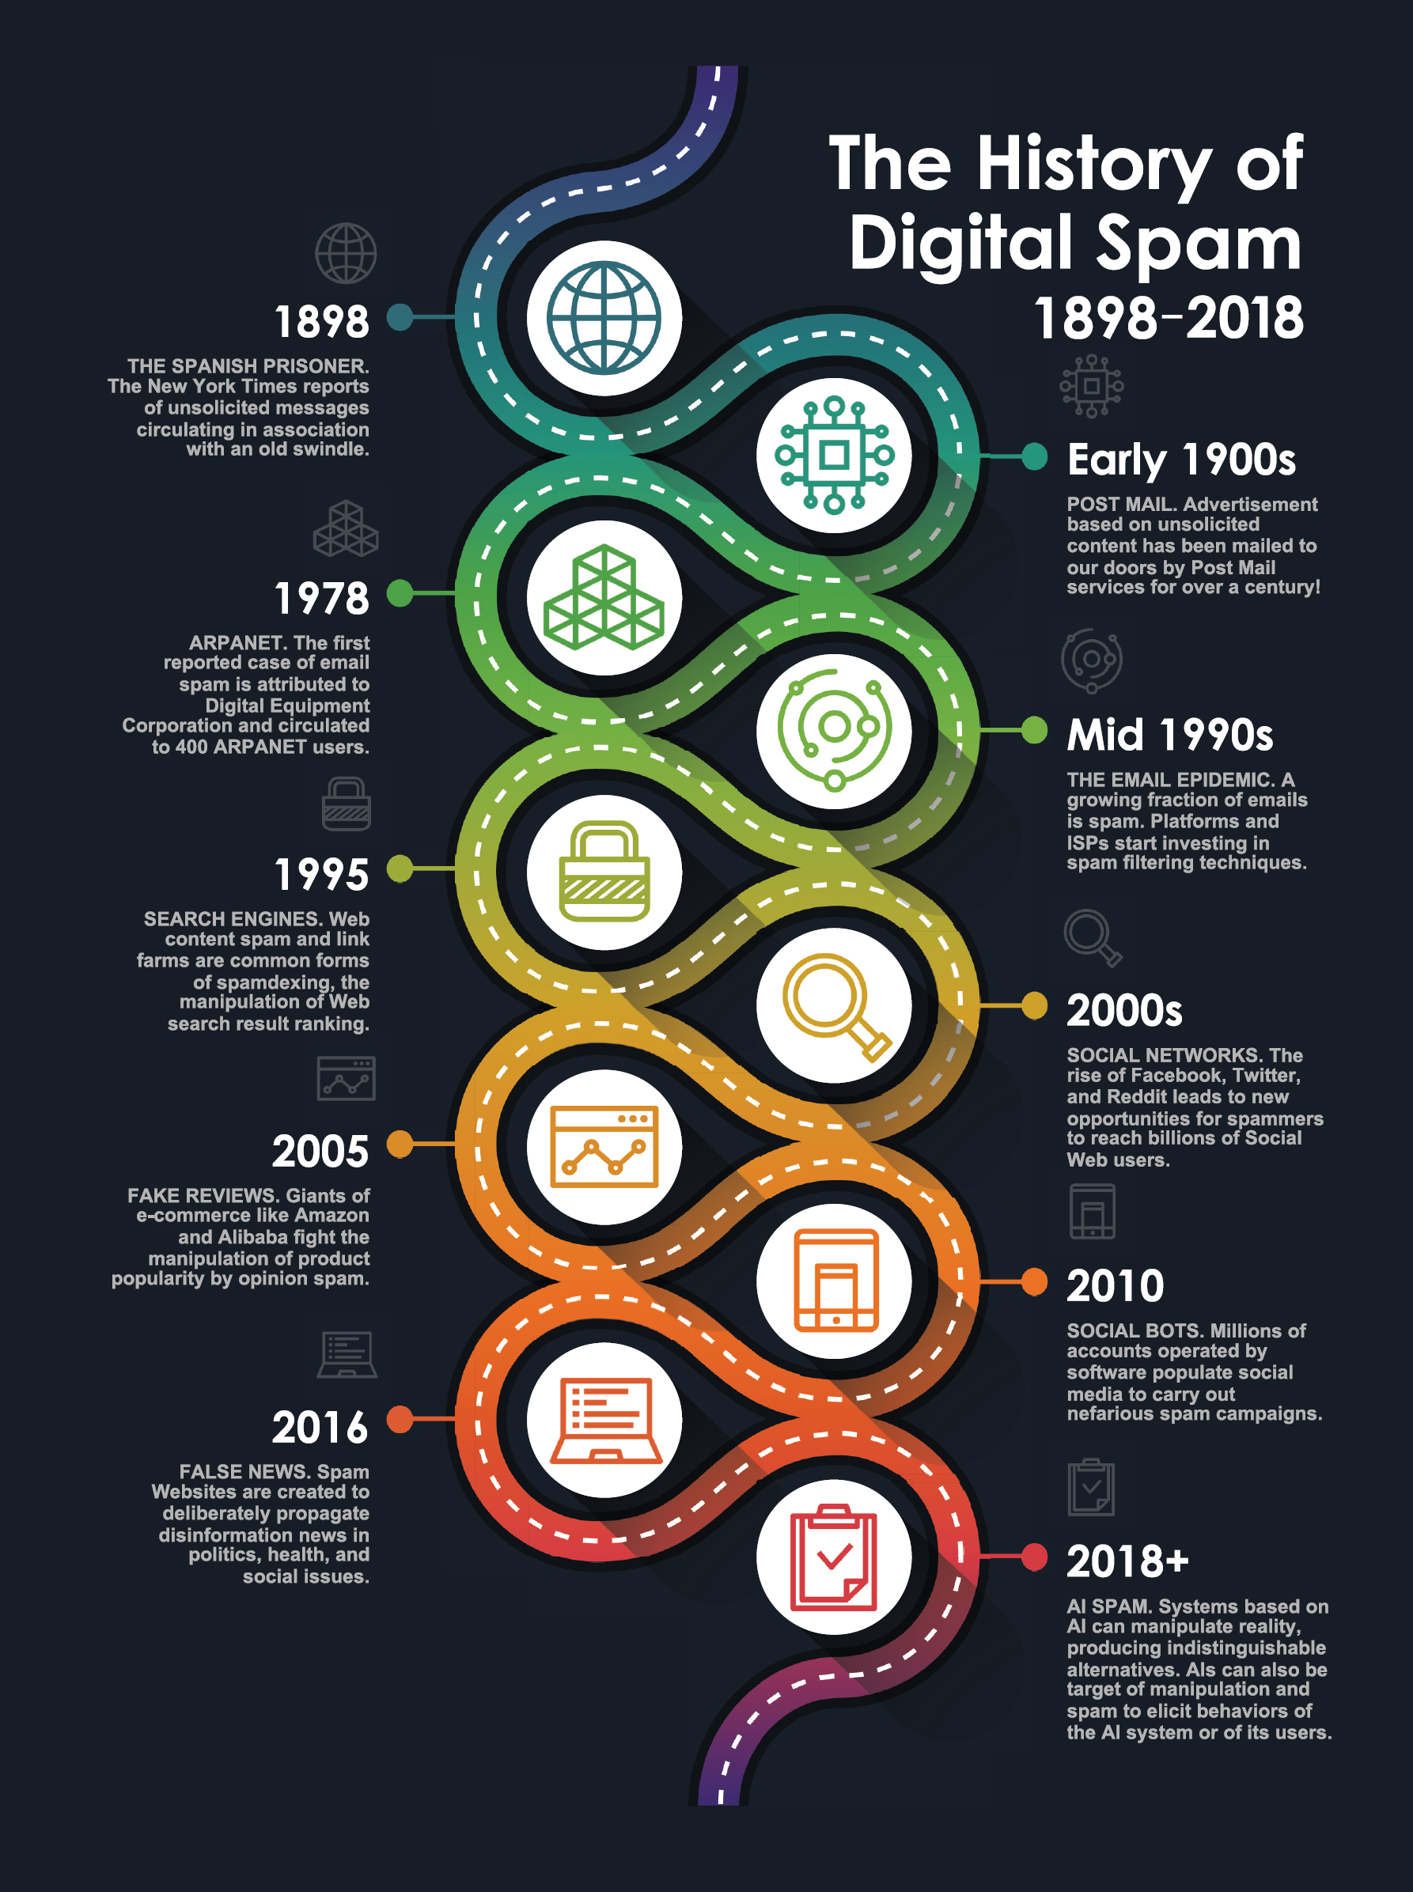
Extra history

